Slide 1
Staying active at work by shikha malhotra

Slide 2
Let’s Crunch the numbers
Do you know your current weight and BMI?
https://www.nhlbi.nih.gov/health/educational/lose_wt/BMI/bmicalc.htm
Do you know your waist circumference?
You have a higher risk of developing obesity-related conditions if you are a man whose waist circumference is more than 40 inches or a non-pregnant woman whose waist circumference is more than 35 inches (Source: https://www.cdc.gov/healthyweight/assessing/index.html)
Do you know your average daily calorie requirement?
Total Daily Energy Expenditure (TDEE) kcal/day = BMR x Physical Activity Level Constant
Physical activity level constant = 1.2 (sedentary), lightly active (1.375), moderately active (1.55), very active (1.725), extremely active (1.9)
Do you know how many steps per day do you walk on average?
Check your smart watch or phone step counter!
Do you know how much exercise you need?

Slide 4
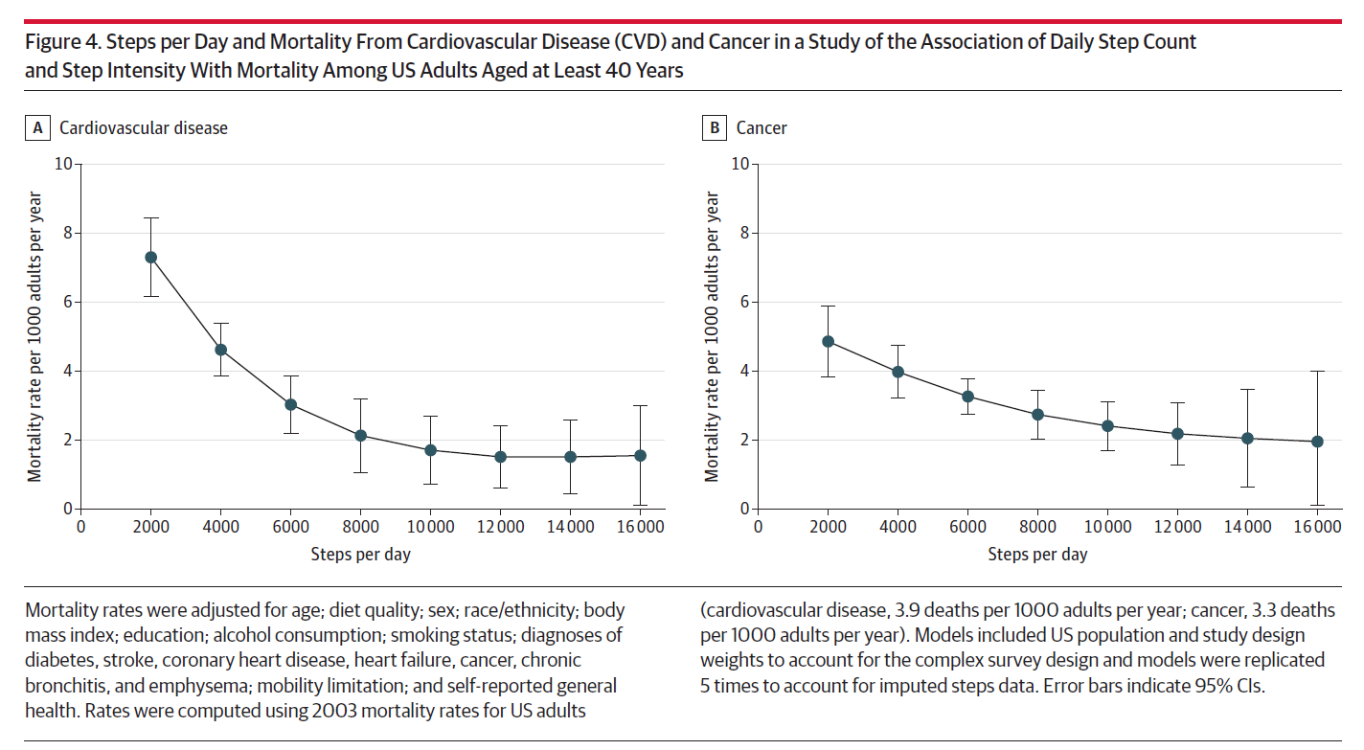

Slide 7
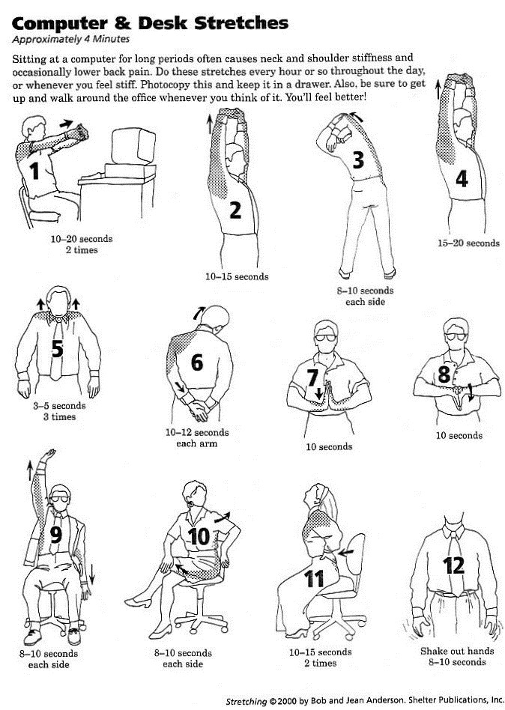
Desk Exercise Printout
How about a walk?
Alternate sitting and standing
Reset your posture
Keep a water bottle on your desk
Set a timer – Alexa/Siri/Google

Slide 8
Walk?!
To or from work
Instead of that email you were about to send
Instead of using the elevators (use the stairs)
While reading a paper or textbook
While dictating cases
While attending (some) meetings
While you wait for the Keurig to do its job
When you realize you are just chatting
While brushing your teeth ☺
“Can I do this standing or walking?”

Slide 9
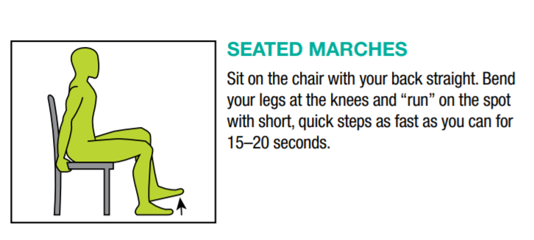
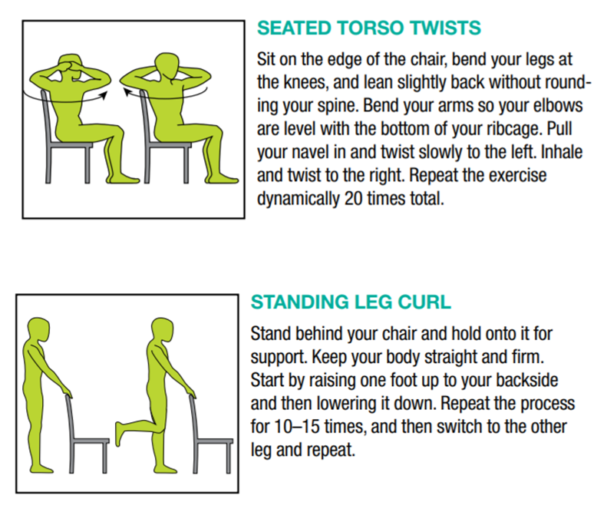
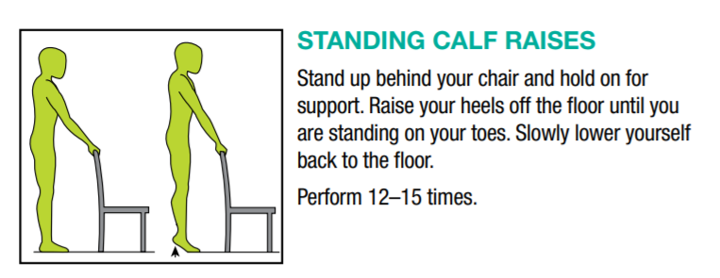
Source: NASA Deskfit document

Slide 10
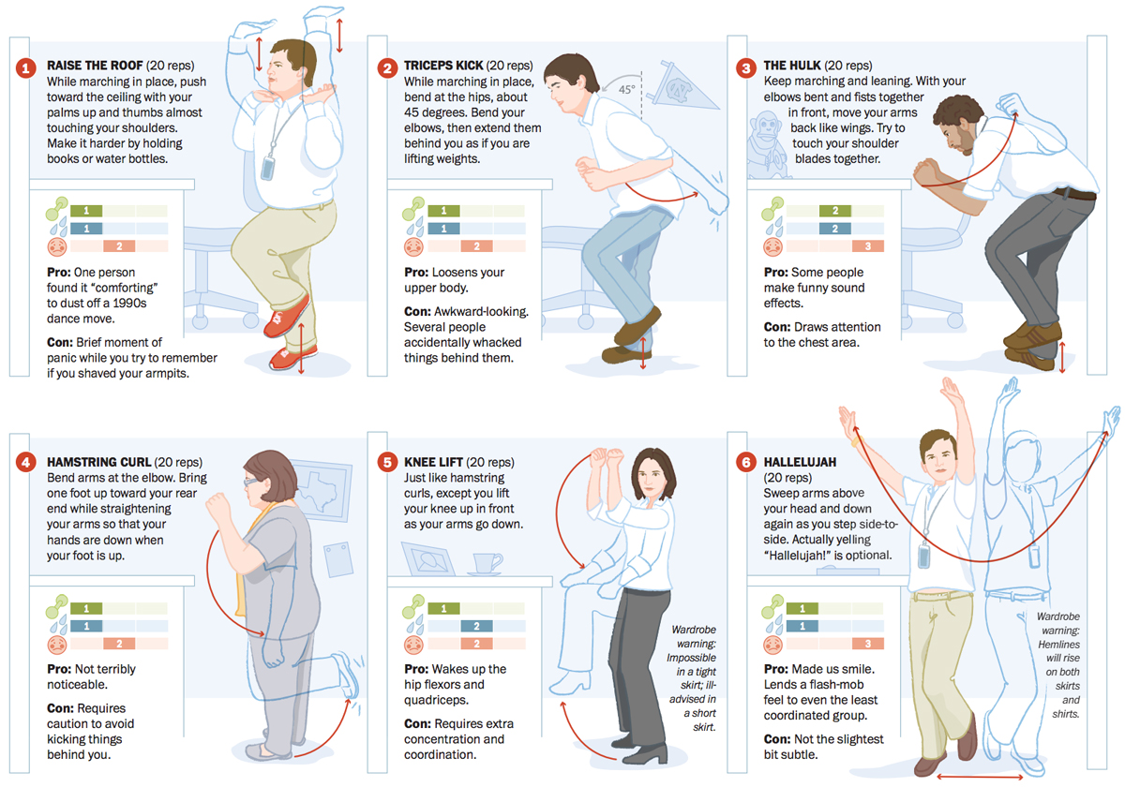
Source: https://www.washingtonpost.com/graphics/health/workout-at-work/

Slide 12
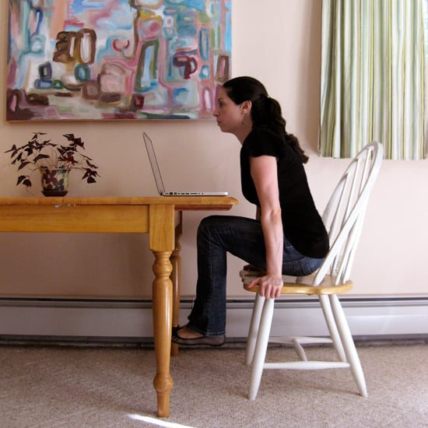
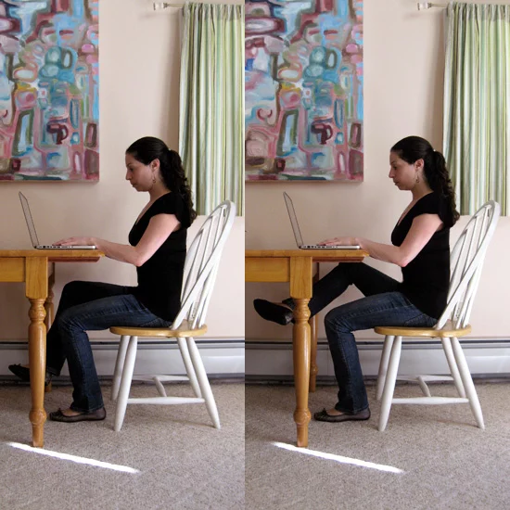
Ab Lift
Chair Squat
Inner Thigh Knee Lift
Source: https://www.popsugar.com/fitness

Slide 13
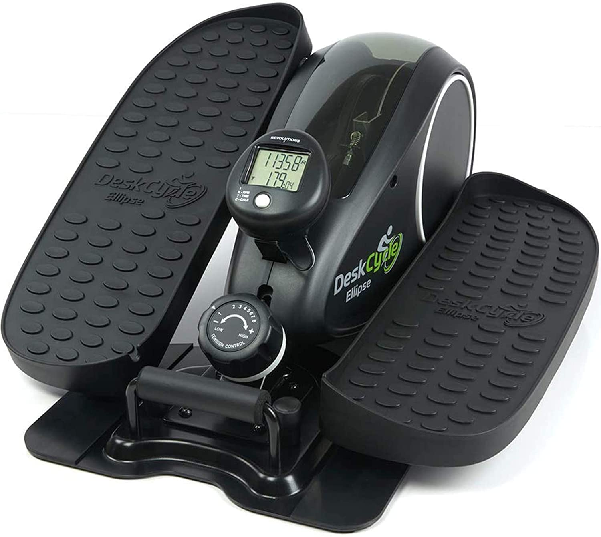
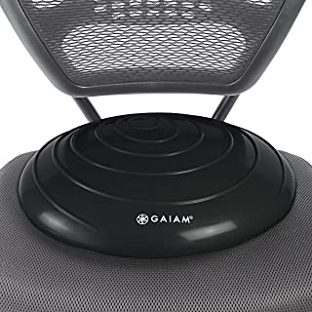
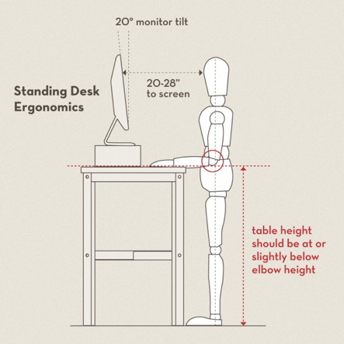
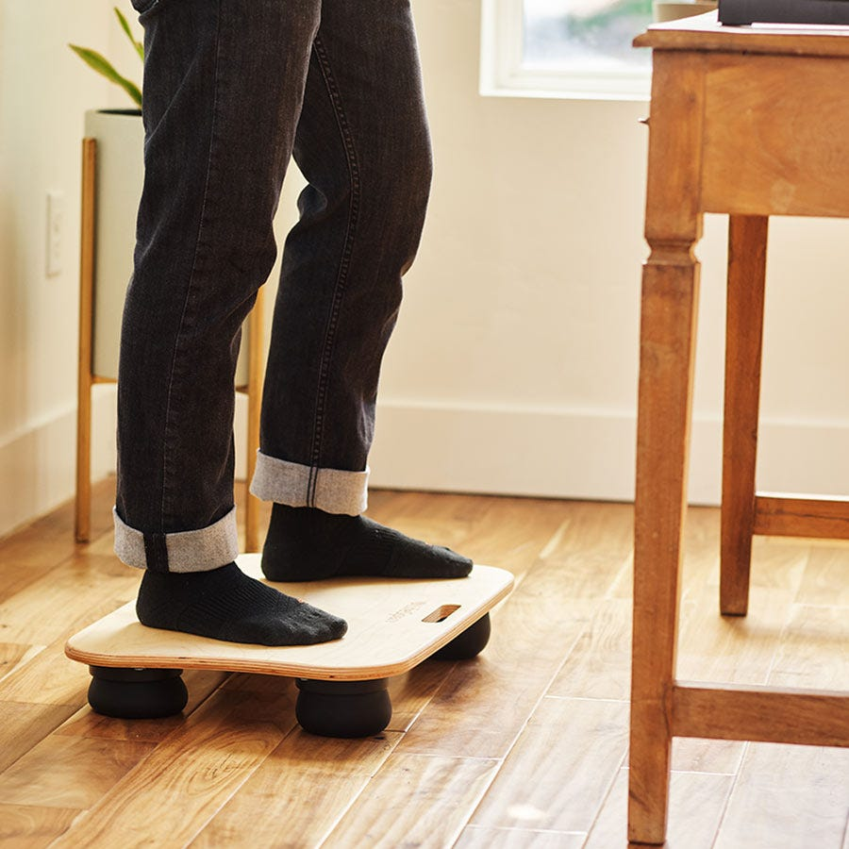
Desk Exercise Tools:
Step counters (Smart watches, phones, basic devices)
Balance board
Stability cushion
Hand exercise (squeezy) balls
Grip training tools
Gyro ball
Small weights
Ankle weights
Stretch bands
Under desk elliptical
Under desk pedal exerciser
Treadmill desk

Slide 14
Do you know?
You can get subsidized access to gyms through Active & Fit Direct
You have access to health coaches who can provide more specific information (HR Direct > My Health Online > Coaching)
Lifestyle Management Session
Physical Activity Session
Resources regarding various health topics are available through work partners (https://www.lifesolutionsforyou.com/ > Login > Corporate login > Company code “upmc”)
Pitt Faculty and staff have access to the facilities in Trees Hall and the Pitt Sports Dome. There are no fees for using these facilities. Valid Pitt ID is needed for access. Please call to check (https://www.studentaffairs.pitt.edu/campus-recreation/facilities-and-hours/)
Gym at Magee Womens’ hospital

Slide 15
Resources
Discreet desk exercises - https://blog.fitbit.com/desk-exercises/
Exercise at your desk (also discreet)- https://www.managerup.com/exercise-at-your-desk/
Simple walking workouts - https://www.youtube.com/c/LeslieSansonesWalkatHome/featured
Tackling neck and back pain at your desk - https://www.youtube.com/watch?v=5AAL2RcIxM8&ab_channel=Bob%26Brad
Setting up your computer and desk - https://www.youtube.com/watch?v=1lh8oXnlWik&ab_channel=Bob%26Brad ; https://www.youtube.com/watch?v=K88q_oEwRS8&ab_channel=MayoClinic
Desk Yoga - https://www.youtube.com/watch?v=tAUf7aajBWE&ab_channel=YogaWithAdriene
Deskfit - https://www.nasa.gov/sites/default/files/atoms/files/hq_deskfit_booklet_6.10.2020.pdf
Popsugar Fitness - https://www.popsugar.com/fitness/Desk-Exercises-Strengthen-Abs-Thighs-Buns-19114865
Deskercises to try - https://greatist.com/fitness/deskercise-33-ways-exercise-work
Want a laugh? - https://thecooperreview.com/12-exercises-to-do-at-your-desk/

Slide 16
Thank you!

