Slide 1
Pathology Ergonomics: An Exercise Physiologist's Perspective
Matt Romanish, DO, EP-C

Slide 2
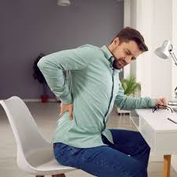


Slide 3
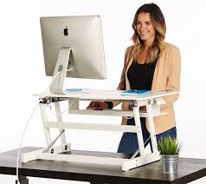
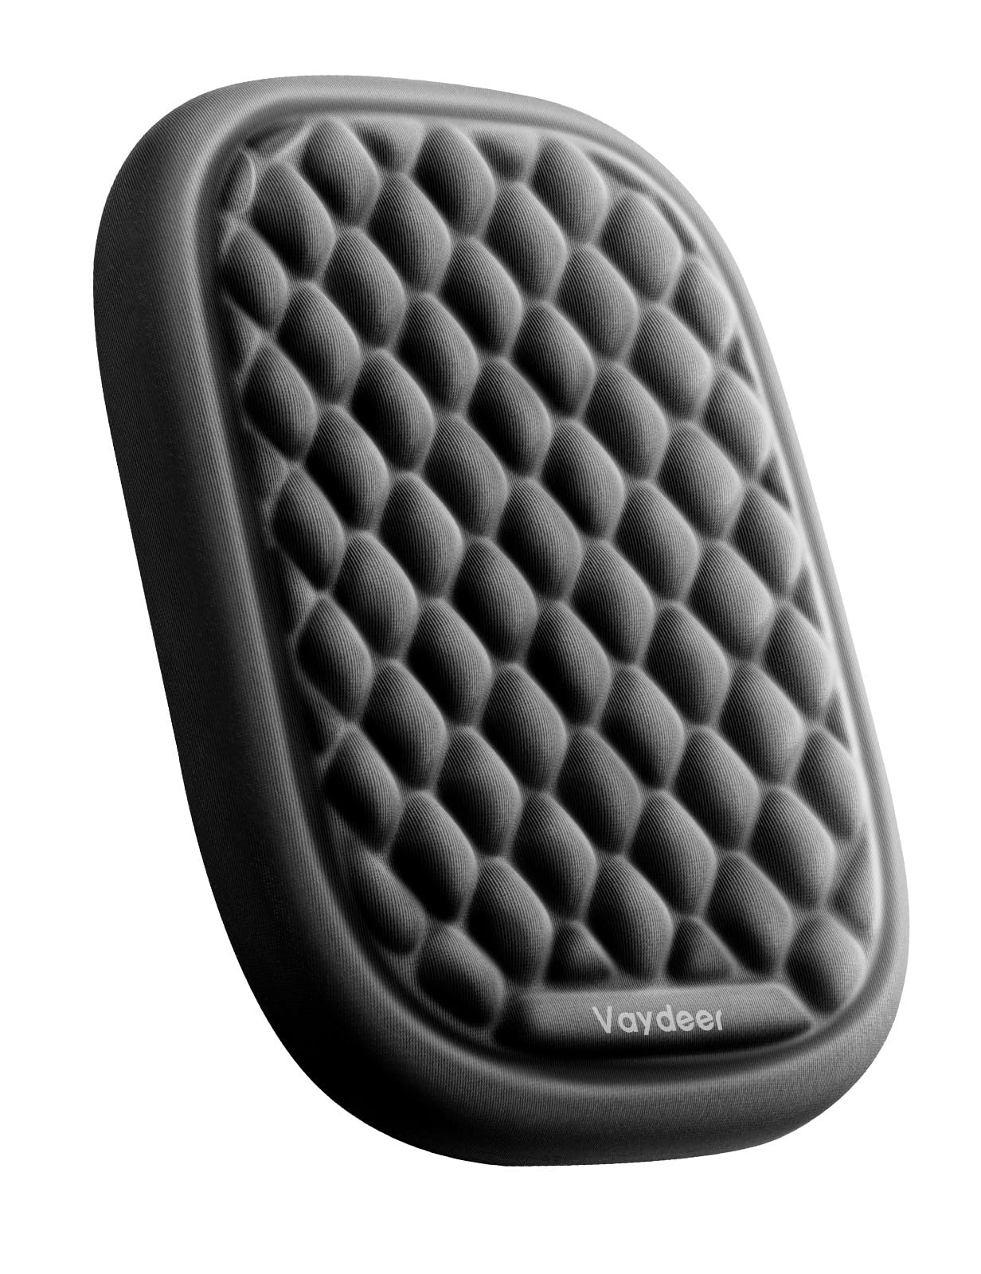
Proper Ergonomics
Height adjustable Desk! Or at least chair
Shoulders relaxed at your side
Eyes aligned with the microscope eyepiece
Chin tucked back and not lifted
Forearms supported on cushions, if possible
Adjust the eye piece to avoid a forward head position

Slide 4
Proper Ergonomics
If sitting, chair that provides good back and thigh support.
Sit with your back against the back rest and your feet supported on the chair ring or footrest.
Elevate, tilt or move the microscope closer to the edge of the counter to avoid bending your neck

Slide 5
Proper Ergonomics
If not adjustable,
  books or binders under the microscope to elevate it
  Raise your microscope to position yourself to reduce tilting your head and rounding your shoulders.
If your microscope is too high
  elevate your chair and use a chair ring or footrest for leg support
An angle so you can look directly into the eyepiece
Avoid leaning on hard edges or use a pad to cushion the edges

Slide 6
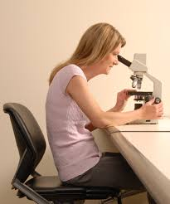
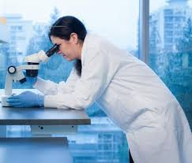

Slide 7
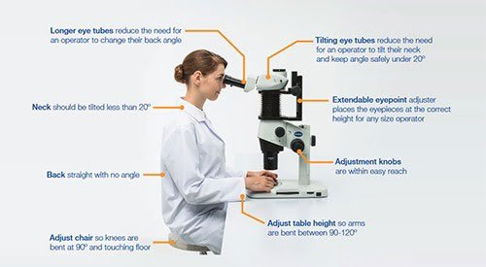
Notes:
https://www.qualitydigest.com/inside/customer-care-article/ergonomic-microscopes-olympus-improve-productivity-072621.html

Slide 8
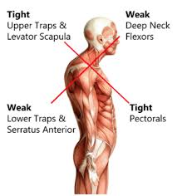
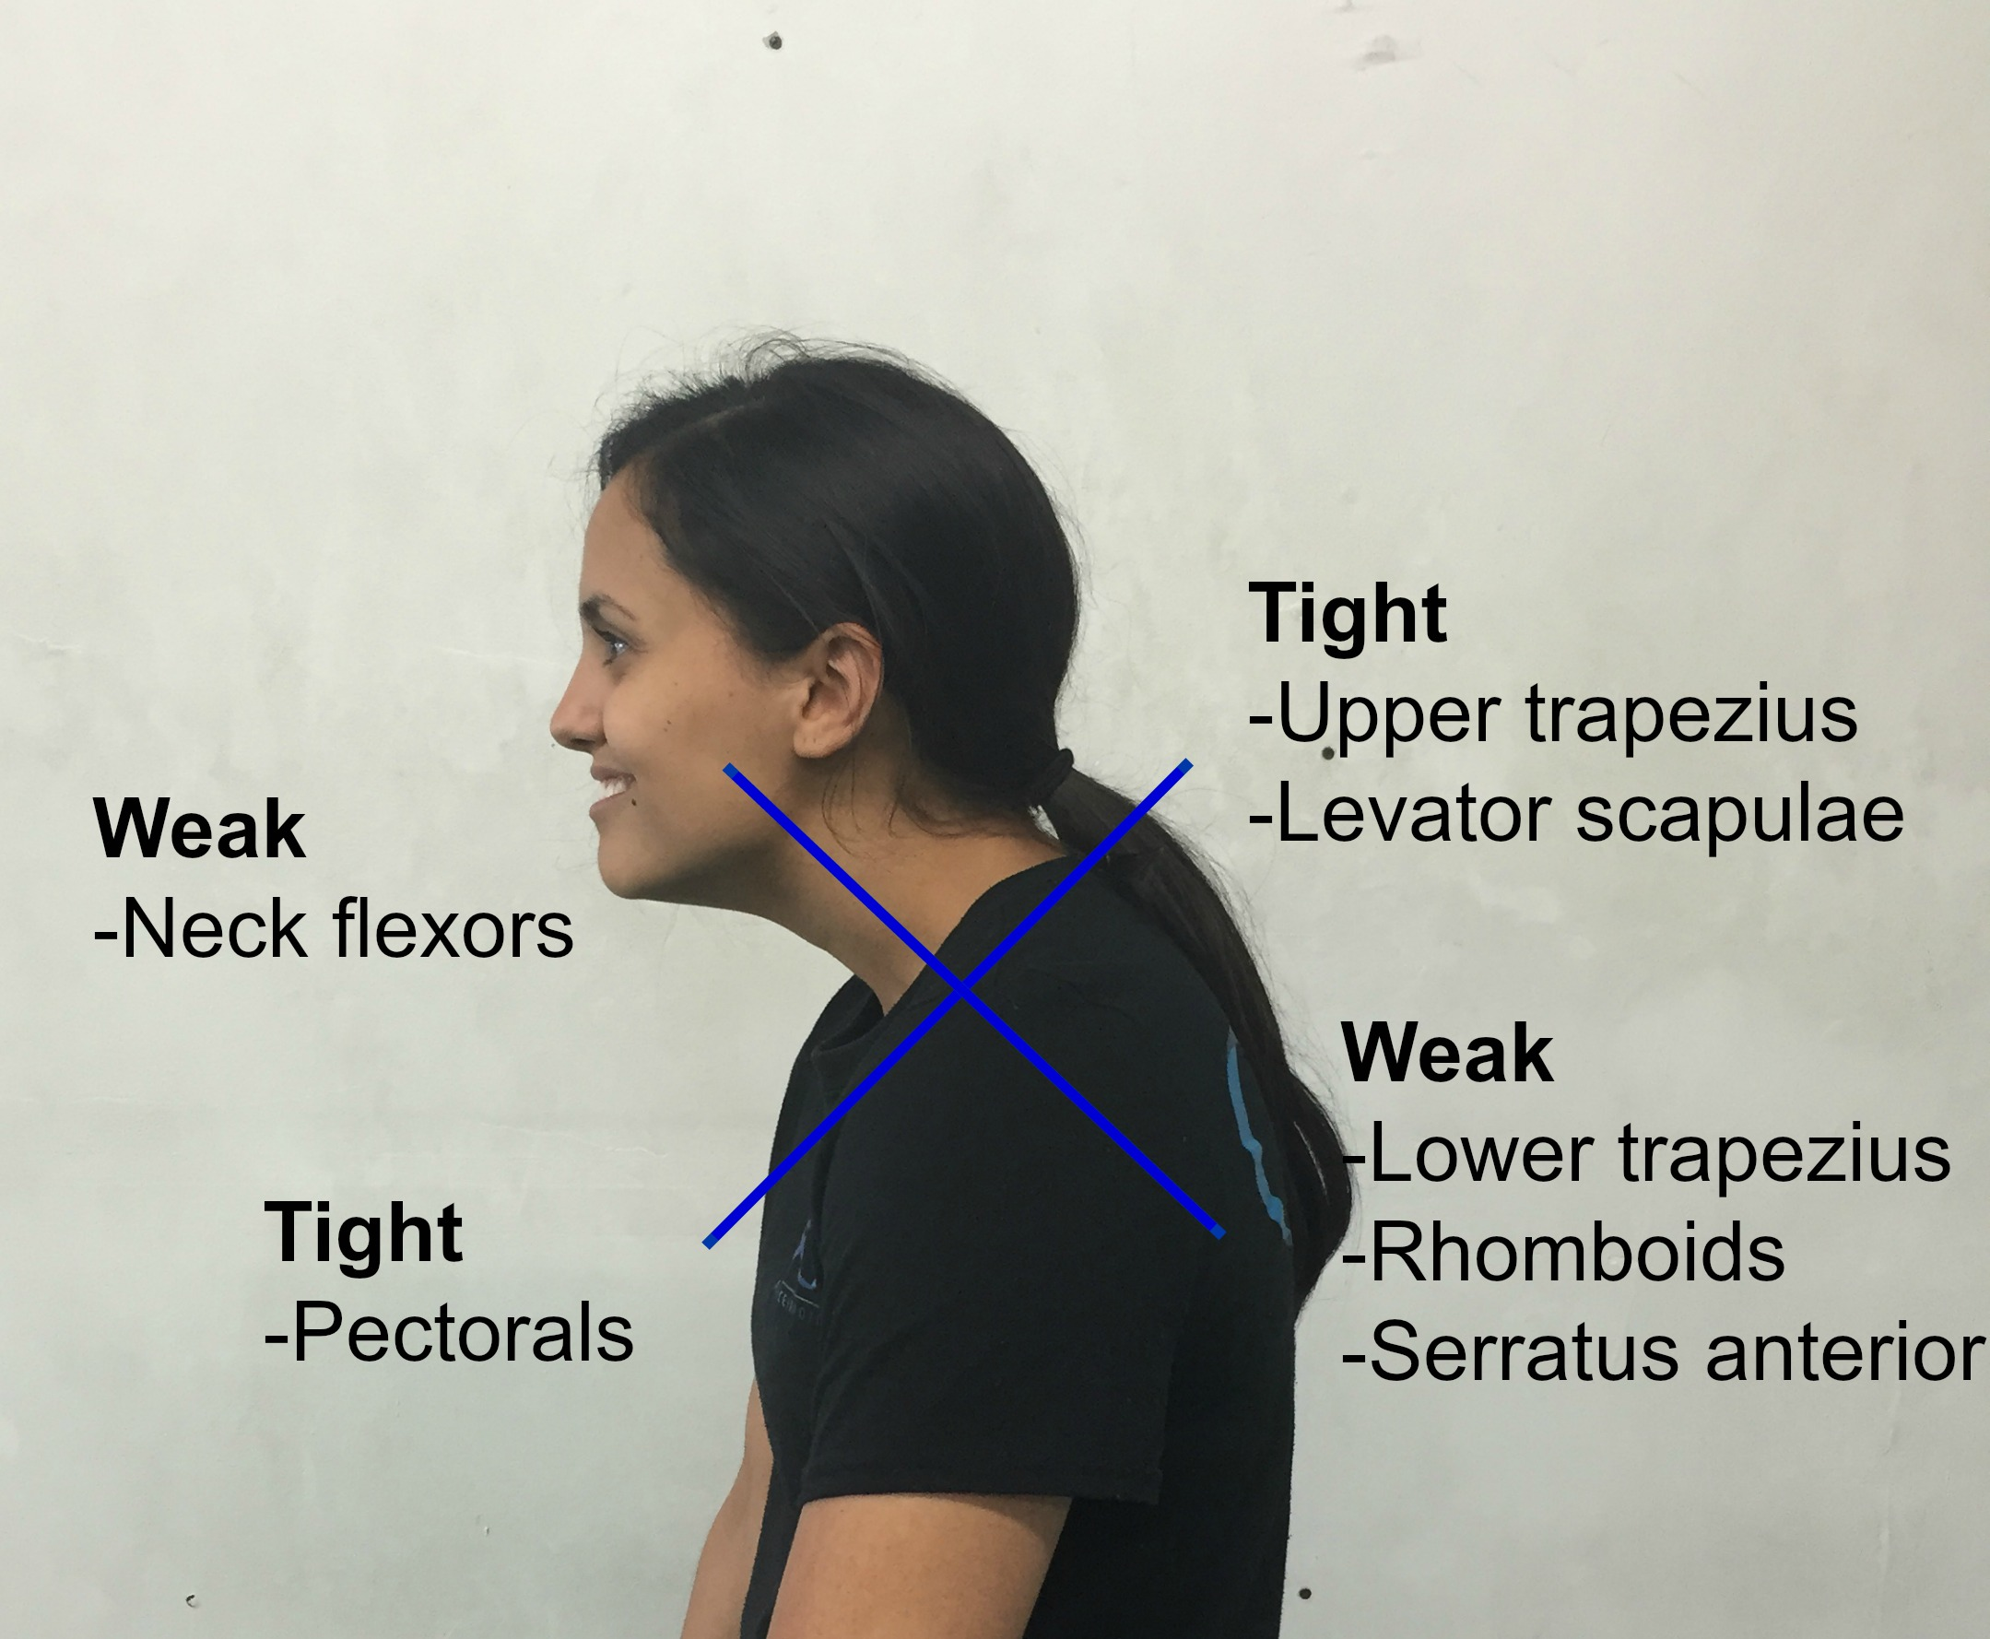
Upper Cross Syndrome

Slide 9
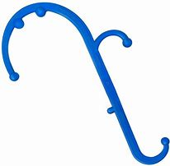
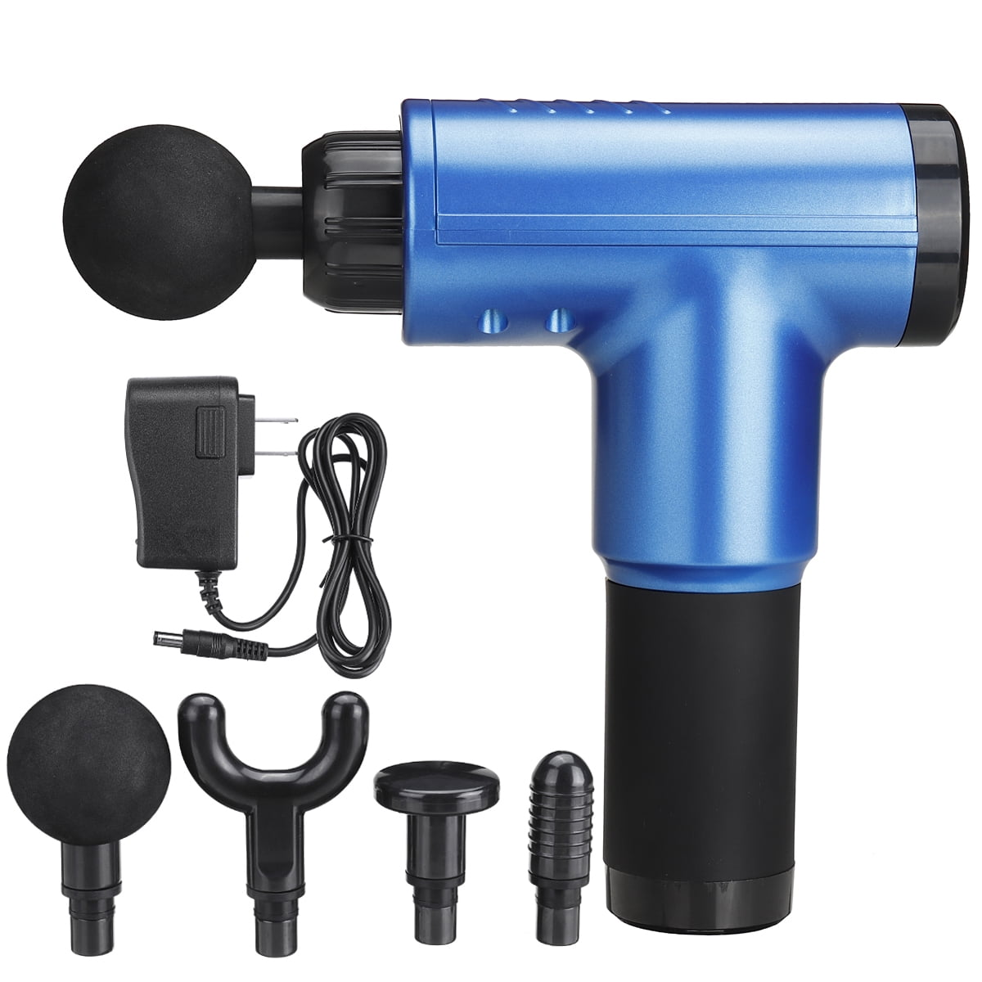
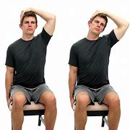
How to fix it?
Proper set up
Self MFR
Stretch before strengthen (20-30 sec)
Notes:
Tuck chin and slowly draw left ear to left shoulder.

Slide 10
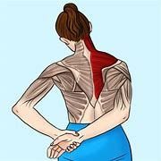
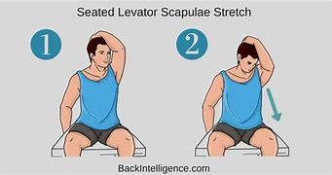
Upper Trap/ Lev Scap

Slide 11
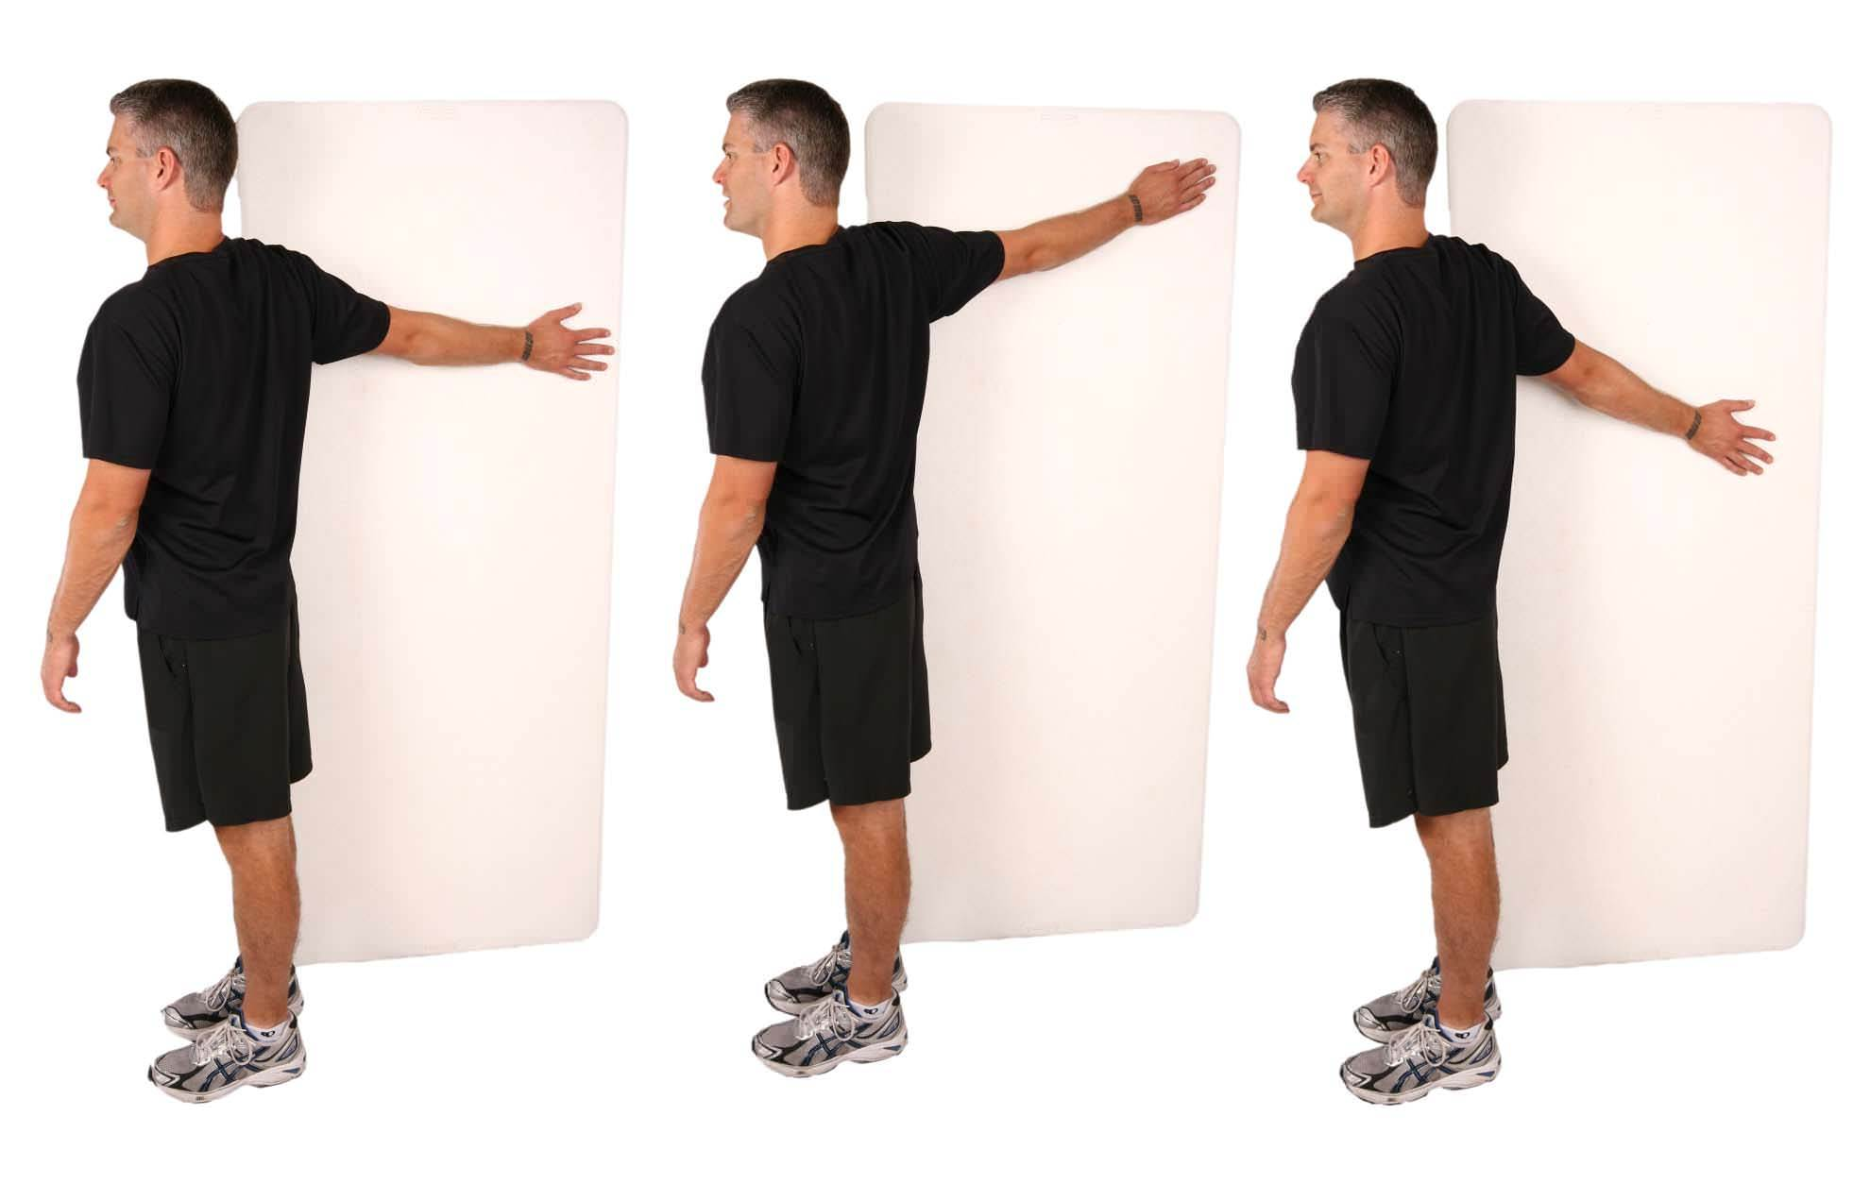
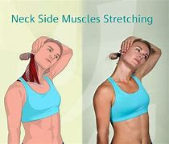
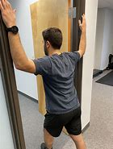
SCM/ Pec

Slide 12
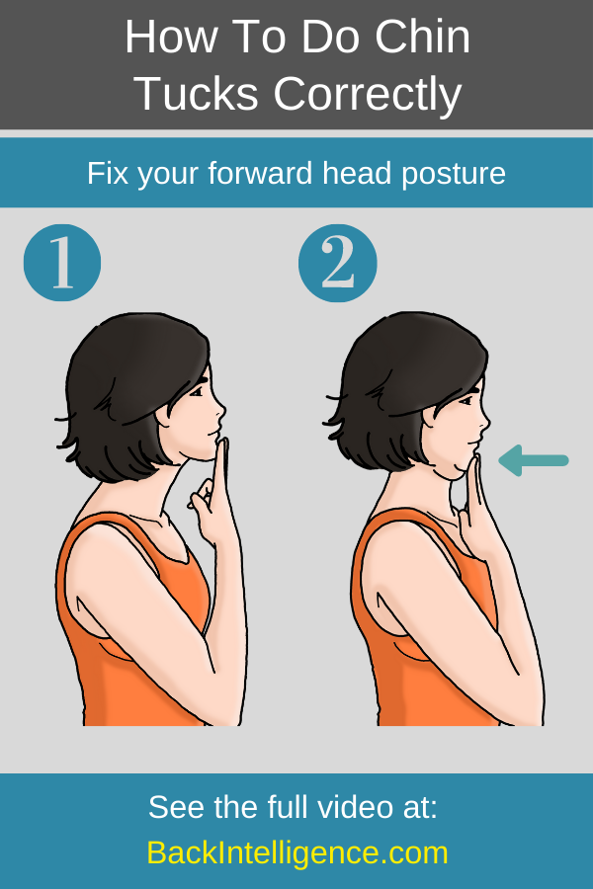
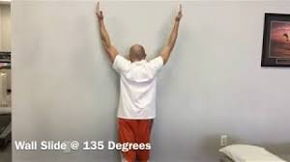
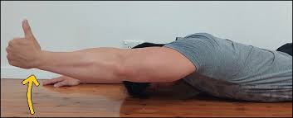
Deep Flexors/ Lower Traps

Slide 13
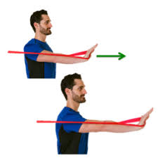
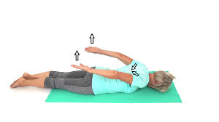
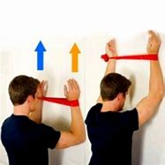
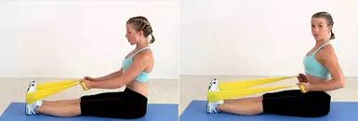
Strengthen

Slide 14
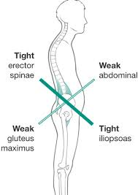
Lower Cross Syndrome

Slide 15
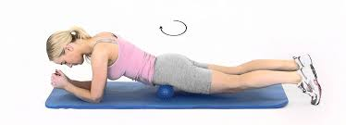
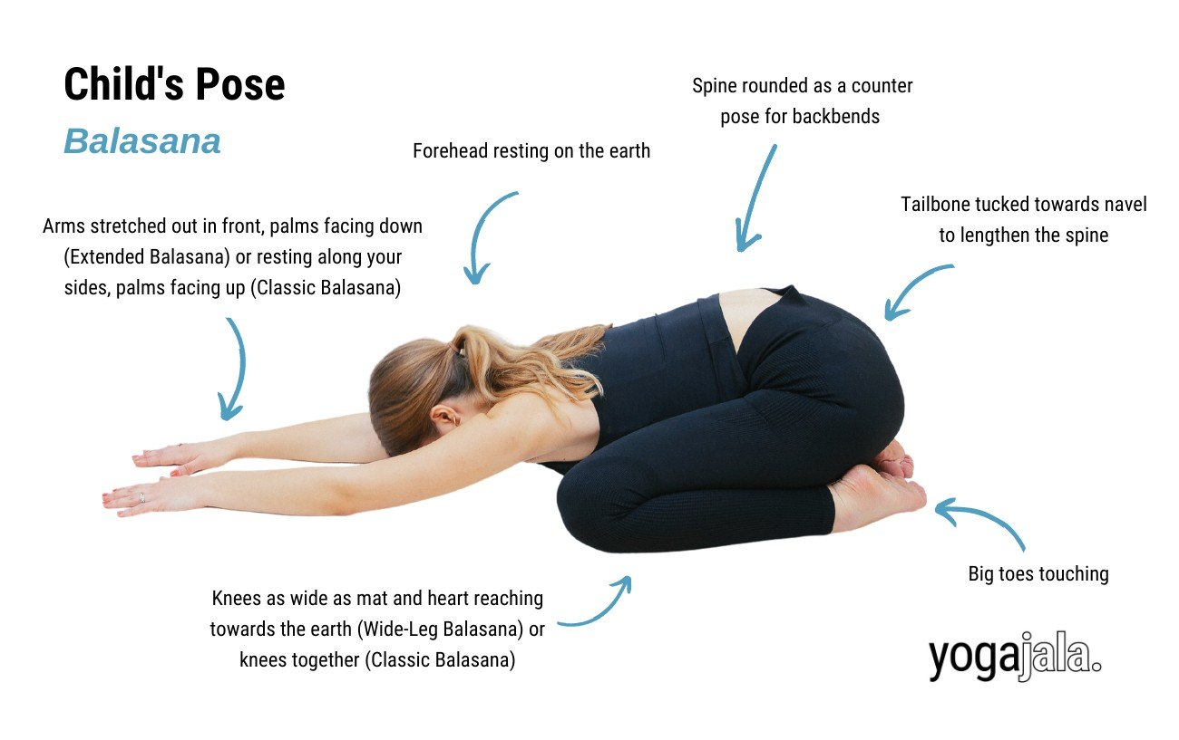
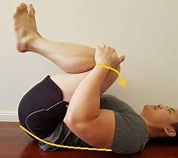
Psoas MFR, Erector spinae stretches

Slide 16
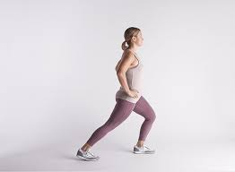
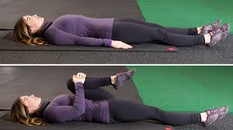
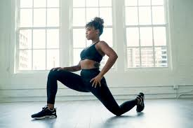
Hip flexor stretches

Slide 17
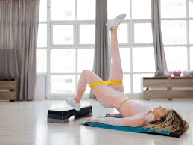
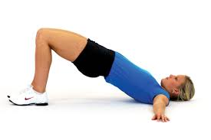
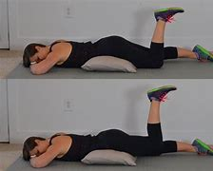
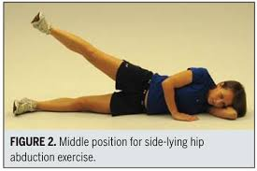
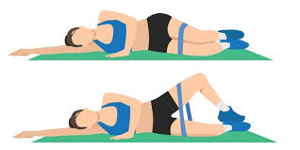
Glute Strengthening

Slide 18
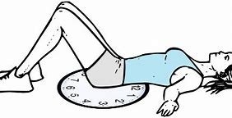
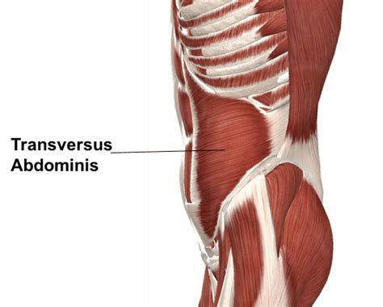
Transversus Abdominus Strengthening
Natural weight belt
Belly button tucks
Pelvic clock

Slide 19
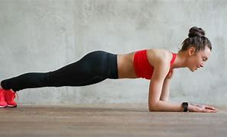
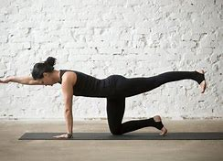
Core strengthening

Slide 20
Final Tips and Tricks
ACSM recommends 150 min of moderate aerobic physical activity a week
  5-10 minutes increments
At least 2 days of resistance exercise of all major muscle groups
Take a break every hour to stretch or move for 5 minutes
Take the stairs
Walk for stress relief

Slide 21

Questions?
Helpful Videos and Websites:
  https://www.youtube.com/watch?v=rOwm-XS2nvE (overall Upper cross syndrome)
  https://www.youtube.com/watch?v=r7ZSEd0E908&t=35s (lower trap Exercises)
  If You Want a Bigger, Stronger Chest – Stop Doing THIS! (First 6 minutes for chest stretching explained)
  https://www.youtube.com/watch?v=yghNB3z0Ulw&t=160s (More helpful explanation)
  https://www.youtube.com/watch?v=U5VtjFywhIA (great stretches for Lower crossed syndrome)
  https://www.youtube.com/watch?v=KqR1EoEmq9c (chin tucks explained)
  https://www.youtube.com/watch?v=x6DyLXdi_Jk (serratus anterior exericses)
  https://www.youtube.com/watch?v=GwPe0JwYbrA (Gluteus Medius Exercises)
  https://www.youtube.com/watch?v=5J8RIIvEj6k (Anterior pelvic tilt explained)
  Pelvic Clock (explanation)

